Slide 1
CAPSTONE PROJECT
RETAIL SALES PREDICTION OF STORE
SHAJAD

Slide 2
Table of content
Objective
Data Summary
Data loading and exploration
Data Wrangling
Column wise analysis
Feature engineering
Algorithm results
Algorithm that we use
Technique and methods we used
Challenges
Reference
Conclusion

Slide 3
Objective
Rossmann operates over 3,000 drug stores in 7 European countries. Currently, Rossmann store managers are tasked with predicting their daily sales for up to six weeks in advance. Store sales are influenced by many factors, including promotions, competition, school and state holidays, seasonality, and locality. With thousands of individual managers predicting sales based on their unique circumstances, the accuracy of results can be quite varied.
we are provided with historical sales data for 1,115 Rossmann stores. The task is to forecast the "Sales" column for the test set. In this data some stores were temporarily closed for refurbishment.

Slide 4
Data summary
Id - an Id that represents a (Store, Date) duple within the set
Store - a unique Id for each store
Sales - the turnover for any given day (Dependent Variable)
Customers - the number of customers on a given day
Open - an indicator for whether the store was open: 0 = closed, 1 = open
StateHoliday - indicates a state holiday. Normally all stores, with few exceptions, are closed on state holidays. Note that all schools are closed on public holidays and weekends. a = public holiday, b = Easter holiday, c = Christmas, 0 = None
SchoolHoliday - indicates if the (Store, Date) was affected by the closure of public schools
StoreType - differentiates between 4 different store models: a, b, c, d
Assortment - describes an assortment level: a = basic, b = extra, c = extended. An assortment strategy in retailing involves the number and type of products that stores display for purchase by consumers.
CompetitionDistance - distance in meters to the nearest competitor store
CompetitionOpenSince[Month/Year] - gives the approximate year and month of the time the nearest competitor was opened

Slide 5
Promo - indicates whether a store is running a promo on that day
Promo2 - Promo2 is a continuing and consecutive promotion for some stores: 0 = store is not participating, 1 = store is participating
Promo2Since[Year/Week] - describes the year and calendar week when the store started participating in Promo2
PromoInterval - describes the consecutive intervals Promo2 is started, naming the months the promotion is started anew. E.g. "Feb,May,Aug,Nov" means each round starts in February, May, August, November of any given year for that store

Slide 6
Data loading
Data loading
Loading the data from google drive and read into notebook
Data exploration
Checking data in different column
Data operations
Cloumns
Numerical columns and the cetagorical columns
Data
Information anddata type of columns

Slide 7
Data wrangling
Data wrangling-also called data cleaning, unifying messy and complex data sets to a meaningful format for easy access and analysis.There are various processes designed to transform raw data into more readily used formats.
*It includes following steps:
Handling missing values.
Removing duplicates data.
Converting columns to proper data type format.
Adding or removing columns for analysis.

Slide 8
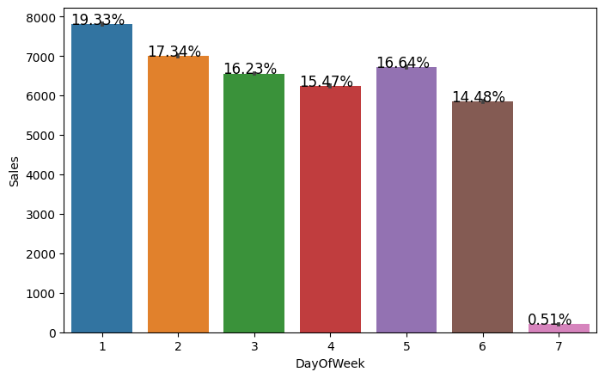
Column wise analysis
In this plot we show that Monday have the maximum sales because of Sunday store are closed .
In ths plot we show that on Sunday there are some sale hapining it means that some stores are open on sunday

Slide 9
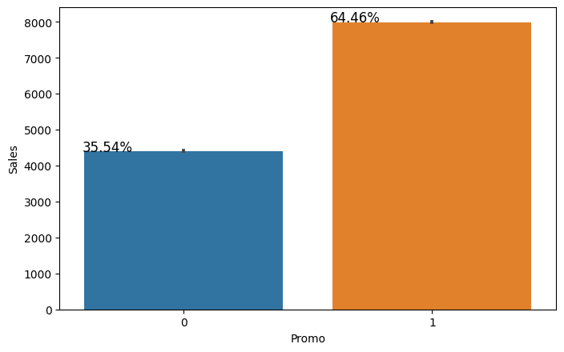
In this plot we show that promo leads to increase the sale of the stores

Slide 10
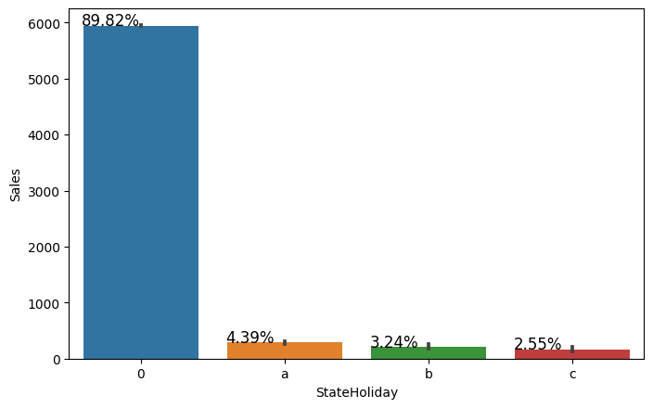
In this plot we show that During the state Holiday the sales in mostly at its lower it means most od the store are closed on state Holidays

Slide 11
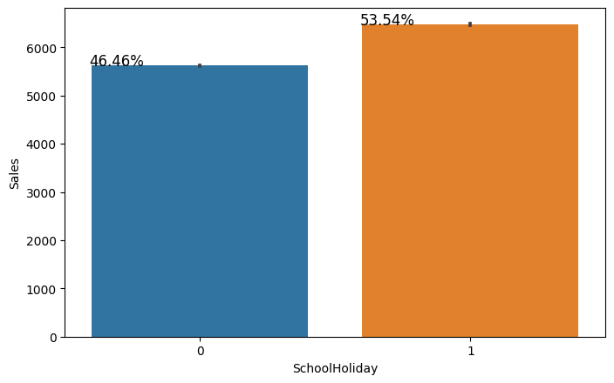
In this plot the sales remains the same on school holiday it means the school holiday does not affect the sales of the stores

Slide 12
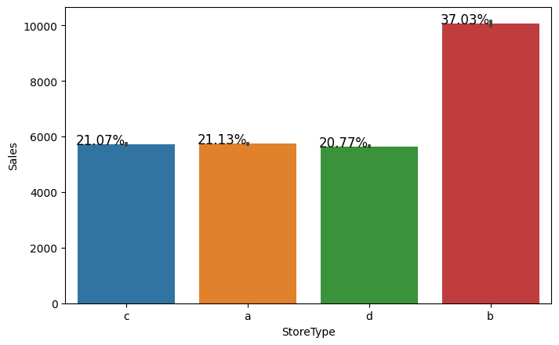
Store type B have the more sales then other stores and store A, C, and D have the same sale

Slide 13
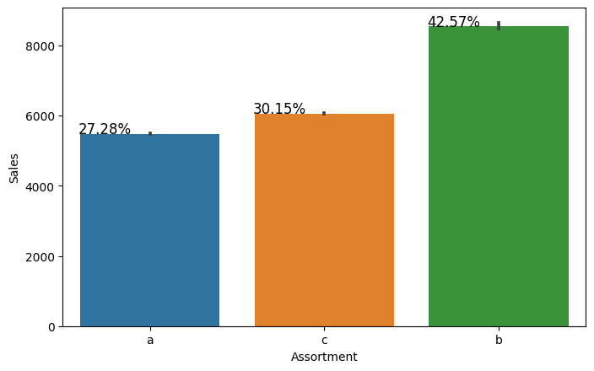
In this graph we show that Assortment b have the maximum sales.

Slide 14
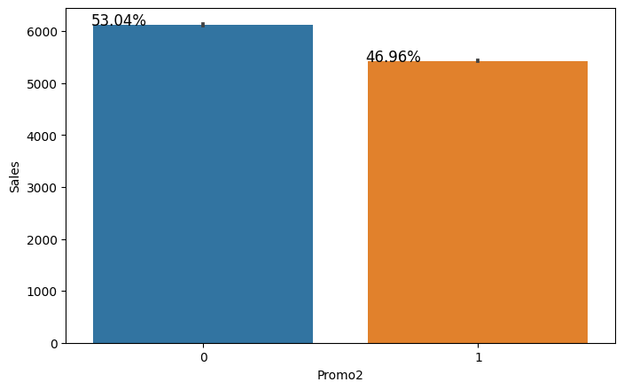
There is no major difference between sales of the promo2

Slide 15
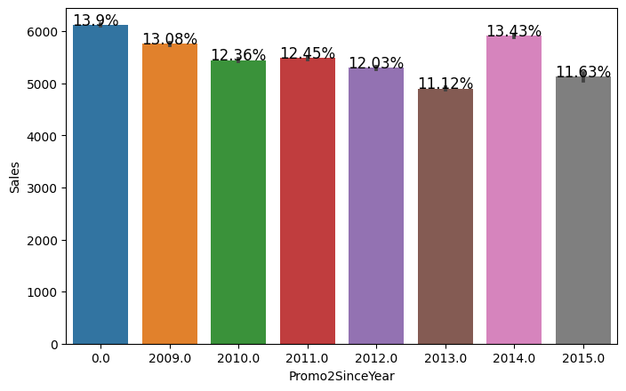
Minimum sales in 2013 and the maximum sales in 2014

Slide 16
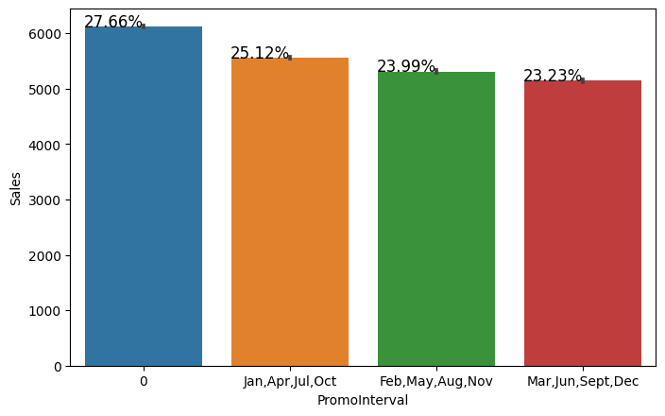
No major difference in promo interval

Slide 17
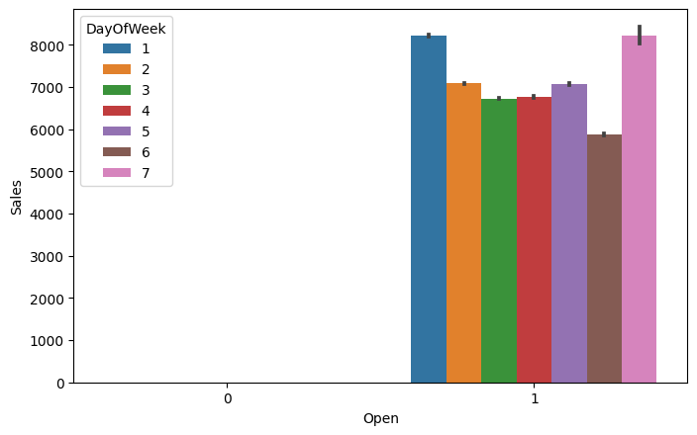
Day 1 and day 7 sales is maximum because of sunday

Slide 18
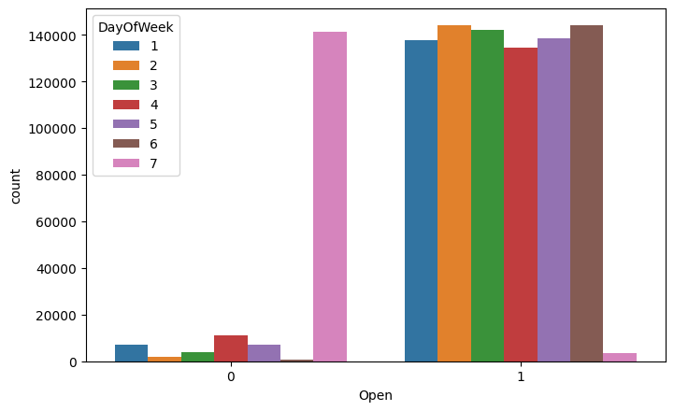
In this figure we show that some stores are closed

Slide 19
Feature Engineering
We convert the date into years and months and days
We find the outliers and remove them
We remove the unnecessary data points
We remove the Promo interval
We set the data into date time object
We split the data into Train dataset and the test dataset

Slide 20
mae : 675.457 mse : 1196128.414 R2: 0.8772284157748653

Slide 21
Algorithm result
Algorithm | MSE | MAE | R2
Random forest | 1224374.55 | 674.975 | 0.87432
Decision tree | 2062634.76 | 865.266 | 0.7882
Random forest CV | 1196128.414 | 675.457 | 0.87722

Slide 22
Algorithm that we use
We use the Decision Tree and Random forest
We calculate the results of both side and we get that the Random forest is performing better then Decision Tree
Then we do some cross validation with the random forest algorithm and then we get more better result

Slide 23
Technique and methods we used
1st we decide the X variables and the Y variables
Then we divide the data into 2 parts Train dataset and the test dataset
And we took the 80 percent data as training data and 20 percent data as a test data
In this project we use the 2 types of the regressor
1st one is the Decision Tree and the 2nd one is the Random Forest
Abd we use the standard scaler as a scaler
Metrics that we are use in this project is 1)r2_score, 2)mean squared error, 3)mean absolute error
And we also use the cross validation in both the regressor

Slide 24
Challenges
Data set having huge data need to segregate . Also, dataset having lots of missing value.
Lots of null values in the dataset.
Handling null values and replace them with Zero or ‘text'. Do with care so that it doesn’t affect analysis.
Choosing visualization for different analysis.

Slide 25
Conclusion
Sales is the most comans factor to determine the revenue of the Stores and revenue affect the decision of making new business plans such as Business budget , incentives , expencess , goals and other plans.
some important conclusion drown from the analysis are as follow
The positive relation between the promo and the sales
in 7th days of the week the sale in likely minimum because of most of the stores are close to Sunday
the sale in 1st day of the week in sale is likely maximum sales of the week because the store are closed on Sunday
sale and open have the direct relationship between the open and the sale
promo is leads the sale and make the sale approximately double
on state holiday sales become approximately 0 but during the school holiday the sales remains the same
B type store have more sales then other and Assortment B have the more sales
In every month sale is always more then 5000

Slide 26
Reference
Almabetter
Geeksforgeeks
StackOverflow
Github

Slide 27
THANK YOU

